Slide 1




Sift/Shift
A retro-style factory game project contributed by:
Jacob Oswald
Ben Potter
Dillon Opperman
Josh Schmidt
Jake Beren
Kristian Neilands

Slide 2
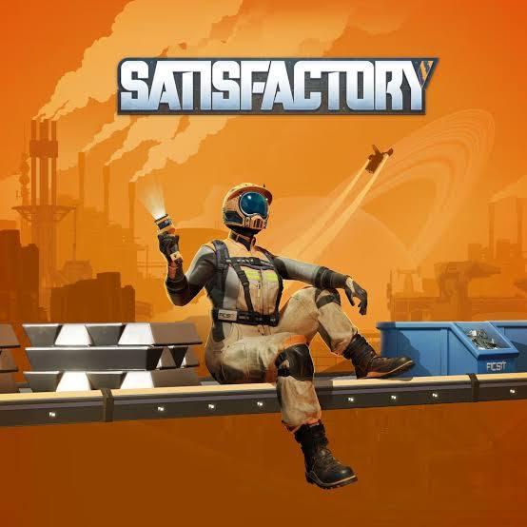
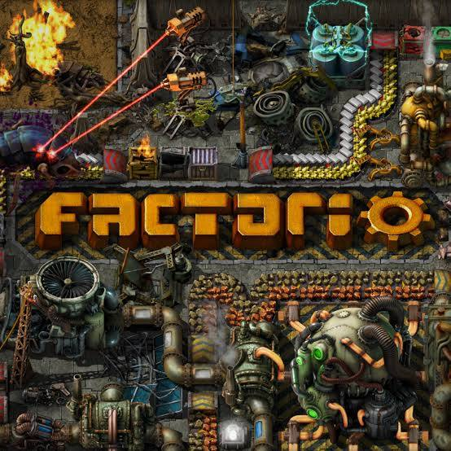
Factory Games
These games are well known for being fun, somewhat math focused games where the player optimizes production in their factory.
They are also known for being overcomplicated, overwhelming, moderately expensive (for indie games), and unfriendly to beginners.

Slide 3
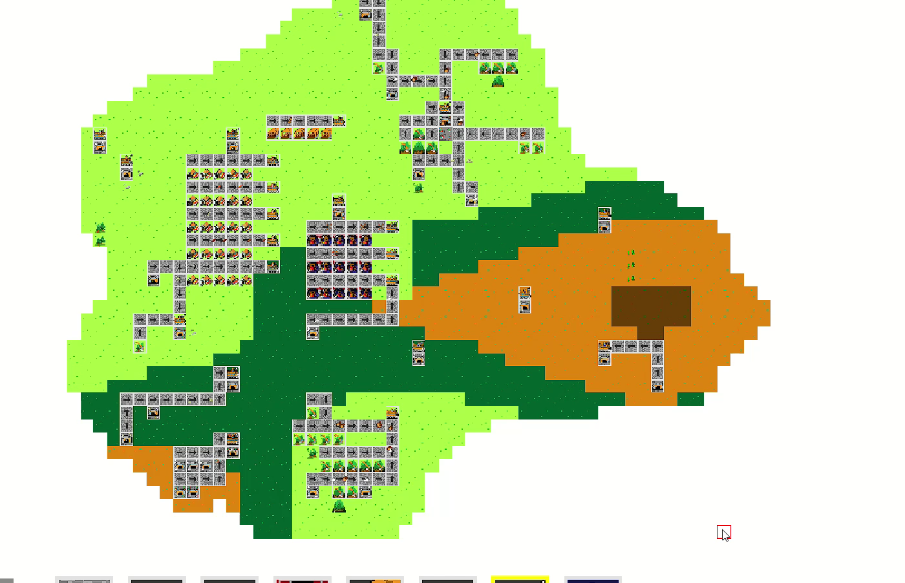
Here is our solution: Sift-Shift
A retro-style, factory sim game that focuses on gameplay
A beginner-friendly and accessible pathway to this genre

Slide 4
Why should you consider our product?
A great introduction to the factory simulation genre
Also, a good entry for retro-style enjoyers

Slide 5
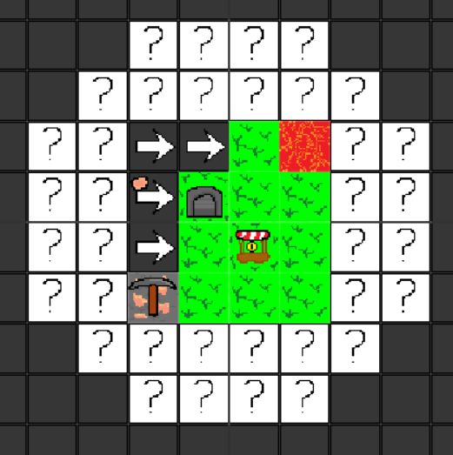
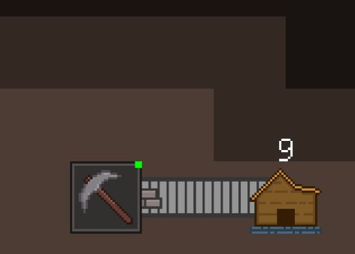
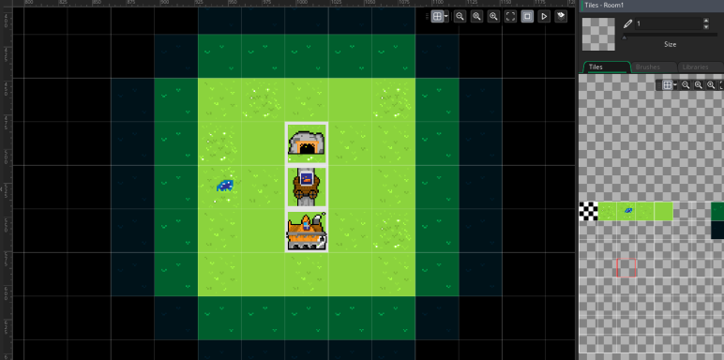
Game Features
In-game economy that progressively ramps up
Increases player goal to keep playing our product.
Tile placement tactics and procedural map generation

Slide 6
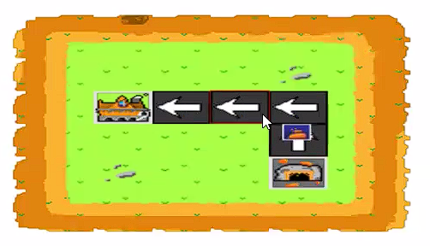
Art Direction
Sprite Work
Retro & Medieval Themed
Apart from UI/Menu elements
Sound Design
How buttons sound, music, etc.

Slide 7
UI & Menu Direction
Accessibility and qualities of life were the biggest priorities.
Connecting front-end to back-end.

Slide 8
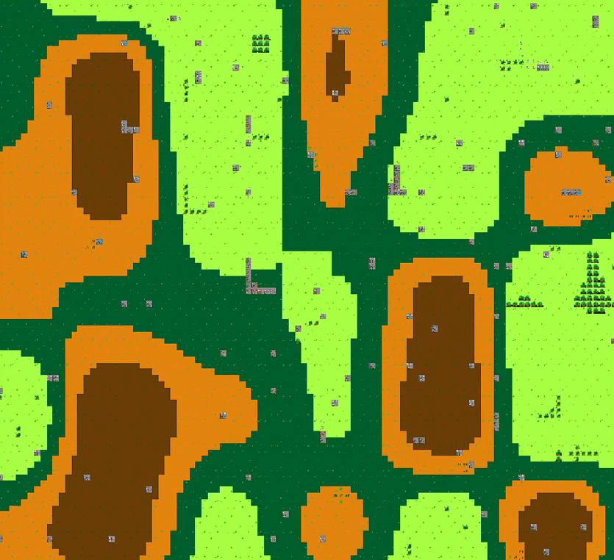
Maps, Merging, & Implementation
The player has 100% creative freedom with the product.
Think of the product as a sandbox.

Slide 9
Demo

Slide 10
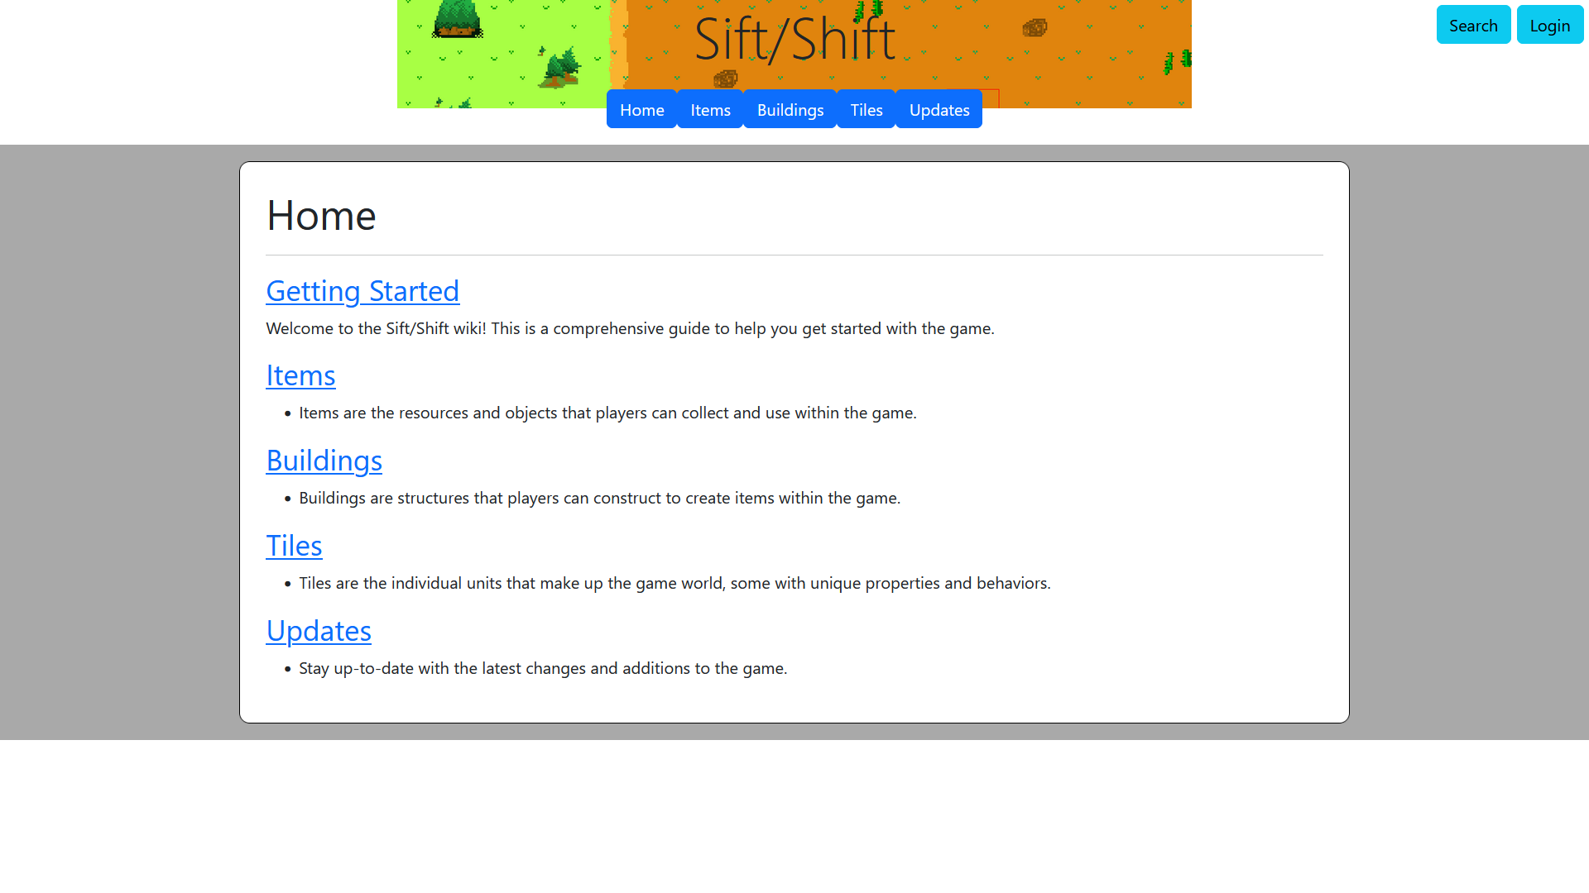
Plans for future implementations
Integration of website
Tutorial from GitHub -> website
More unique regions/tiles/materials
Implementation of mechanics beyond functional scope

Slide 11
Conclusion
We set out to make a game based on real game-dev tactics.
Gameplay, art and sound included
Contributed to the game-dev environment.
And providing our target audience with an acceptable project of the same caliber.

Slide 12
References
Games
Factorio, Wube Software
Satisfactory, Coffee Stain Studios
Shapez, Tobias Springer
Europa Universalis V, Paradox Tinto
Minecraft, Mojang Studios
Beltmatic, Notional Games
Rimworld, Tynan Sylvester
Fire Emblem: Blazing Sword, Intelligent Systems / Nintendo
Elden Ring, FromSoftware
Castlevania: Symphony of the Night, Konami
Skyrim, Bethesda Game Studios
Tutorials Used
Alexander, Mark. “Setting up and Using Source Control.” GameMaker Blog RSS, 14 Apr. 2026, https://gamemaker.io/en/help/articles/setting-up-and-using-source-control
Emil Ludvigsen. “The Easiest Way to Make 8Bit Music in FL Studio .” YouTube, 5 Dec. 2024, http://youtu.be/PciO75NAhtA?si=CoKqmjYBIBLBz_px
Matharoo, Gurpreet. “Make Your Own Role-Playing Game.” GameMaker Blog RSS, 3 Jan. 2025, https://gamemaker.io/en/tutorials/how-to-make-an-rpg

Slide 13
BUY OUR VIDEOGAME BUY OUR VIDEOGAME BUY OUR VIDEOGAME BUY OUR VIDEOGAME BUY OUR VIDEOGAME BUY OUR VIDEOGAME BUY OUR VIDEOGAME BUY OUR VIDEOGAME BUY OUR VIDEOGAME BUY OUR VIDEOGAME BUY OUR VIDEOGAME BUY OUR VIDEOGAME BUY OUR VIDEOGAME BUY OUR VIDEOGAME BUY OUR VIDEOGAME BUY OUR VIDEOGAME BUY OUR VIDEOGAME BUY OUR VIDEOGAME BUY OUR VIDEOGAME BUY OUR VIDEOGAME BUY OUR VIDEOGAME BUY OUR VIDEOGAME BUY OUR VIDEOGAME BUY OUR VIDEOGAME BUY OUR VIDEOGAME BUY OUR VIDEOGAME BUY OUR VIDEOGAME BUY OUR VIDEOGAME BUY OUR VIDEOGAME BUY OUR VIDEOGAME BUY OUR VIDEOGAME BUY OUR VIDEOGAME BUY OUR VIDEOGAME BUY OUR VIDEOGAME BUY OUR VIDEOGAME BUY OUR VIDEOGAME BUY OUR VIDEOGAME BUY OUR VIDEOGAME BUY OUR VIDEOGAME BUY OUR VIDEOGAME BUY OUR VIDEOGAME BUY OUR VIDEOGAME BUY OUR VIDEOGAME BUY OUR VIDEOGAME BUY OUR VIDEOGAME BUY OUR VIDEOGAME BUY OUR VIDEOGAME BUY OUR VIDEOGAME BUY OUR VIDEOGAME BUY OUR VIDEOGAME BUY OUR VIDEOGAME BUY OUR VIDEOGAME BUY OUR VIDEOGAME BUY OUR VIDEOGAME BUY OUR VIDEOGAME BUY OUR VIDEOGAME BUY OUR VIDEOGAME BUY OUR VIDEOGAME BUY OUR VIDEOGAME BUY OUR VIDEOGAME

Slide 14

Q and A

